Slide 1

Test Automation & Advanced Selenium
Introduction to Automation
Git & Jenkin
Lesson 1: Introduction to CI

Slide 2
Test Automation & Advanced Selenium
Introduction to Automation
Lesson Objectives
Why CI? Software development before CI & Software development with CI
Benefits of CI
Overview on various CI tools – Jenkins, Buildbot, Travis, Bamboo
Add instructor notes here.

Slide 3
Test Automation & Advanced Selenium
Introduction to Automation
Introduction to CI
Continuous Integration(CI)
Continuous Integration involves a tool that monitors version control system for any changes and automates application building.
CI system must be executed under configuration management.
Developers are notified automatically if any build action fails.
CI brings a practice to integrate work frequently in software development.
Monitoring of Code Quality and Code coverage metrics is automated.
Add instructor notes here.

Slide 4
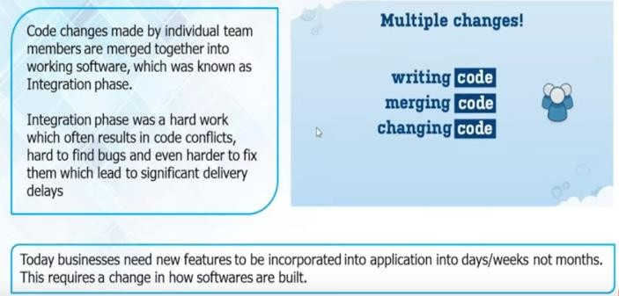
Test Automation & Advanced Selenium
Introduction to Automation
Introduction to CI
Why CI?
Add instructor notes
here.
Software Development Before CI

Slide 5
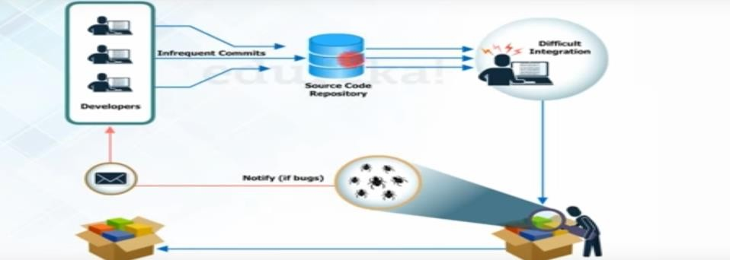
Test Automation & Advanced Selenium
Introduction to Automation
Introduction to CI
Why CI?
Add instructor notes
here.
Software Development Before CI

Slide 6

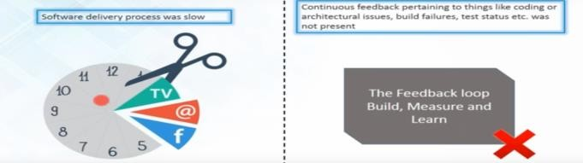
Test Automation & Advanced Selenium
Introduction to Automation
Introduction to CI
Problem-Before CI
Add instructor notes here.

Slide 7
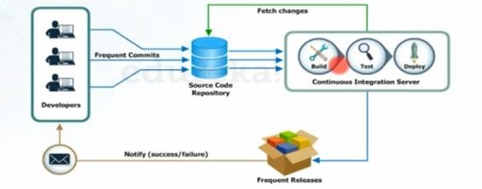
Test Automation & Advanced Selenium
Introduction to Automation
Introduction to CI
Software Development With CI
Add instructor notes
here.
After every commit of the source code an auto build is triggered & then it is automatically deployed on the test server
If the test results shows that there is bug in the code then developer only checks the last commit made to the source code
This also increases the frequency of the new software release The concerned teams always provided with the relevant feedback
1: Application must run under source control management 2: Daily code commits to SVN will be baseline.
3: CI polls for any code changes in SVN and triggers build actions if any.
4: Automated build, testing and deployment of an application will be performed by CI.
5: After build action, developer will be accessible with latest code and build
6: Developers will be notified with any build errors and automated test results.
Need of CI in software Development
Helps to locate code based defects in a centralized location. Tools can be used to automate deployment.
Minimizes integration errors in SVN during build process(Errors are uncovered during Manual Build) by invoking automation.
Increase amount of quality code and improve development standards.

Slide 8
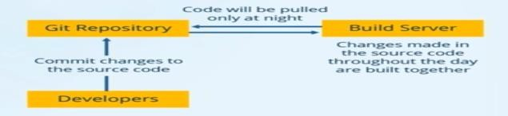
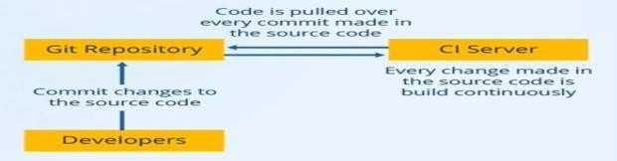
Test Automation & Advanced Selenium
Introduction to Automation
Introduction to CI
Case Study on - CI
Tell about scenario if user is doing with or
without CI .Give example
Without CI
of Nokia uploading
With CI-Problem Solved

Slide 9
Test Automation & Advanced Selenium
Introduction to Automation
Introduction of CI
Continuous Integration -CI
Benefit to CI:
Aims to eliminate code integration issues
Minimizes project risk with notification of defects and code quality issues
Reduces cost of quality
Early warning of conflicting changes code
Automation of build and testing of an application
Add instructor notes here.
Reduce risks
By integrating many times a day, you can reduce risks on your project. Doing so facilitates the detection of defects, the measurement of software health and a reduction of assumptions.
Defects are detected and fixed sooner: Because CI integrates and runs tests and inspections several times a day, there is a greater chance that defects are discovered when they are introduced (i.e., when the code is checked into the version-control repository) instead of during late-cycle testing.
Health of software is measurable: By incorporating continuous testing and inspection into the automated integration process, the software product's health attributes, such as complexity, can be tracked over time.
Reduce assumptions: By rebuilding and testing software in a clean environment using the same process and scripts on a continual basis, you can reduce assumptions (e.g., whether you are accounting for third-party libraries or environment variables).
CI provides a safety net to reduce the risk that defects will be introduced into the code base. The following are some of the risks that CI helps to mitigate. We discuss these and other risks in the next chapter.
Lack of cohesive, deployable software Late defect discovery
Low-quality software Lack of project visibility

Slide 10
Test Automation & Advanced Selenium
Introduction to Automation
Introduction of CI
Continues Integration Tools
Jenkins
Buildbot
Travis CI
Bamboo

Slide 11
Test Automation & Advanced Selenium
Introduction to Automation
Jenkins Introduction
Jenkins
Jenkins is a self-contained, open source automation server which can be used to automate all sorts of tasks such as building, testing, and deploying software.
Jenkins is an open source continuous integration(CI) tool written in java developed by Kohsuke Kawaguchi.
Monitors the change in the source control systems like SVN, CVS, etc.
Builds the application using various build tools like ANT, MAVEN, etc.
Provides a fresh build whenever there is a change in the source control system
Sends messages on the status of the build through Email, SMS, etc
Plugins allows integration of the various DevOps Stage
Add instructor notes here.

Slide 12
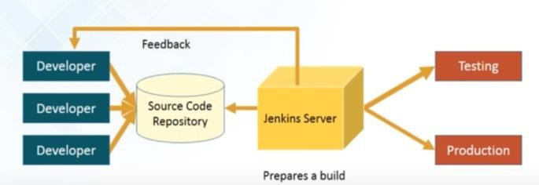
Test Automation & Advanced Selenium
Introduction to Automation
Jenkins Introduction
How Jenkins Works
Add instructor notes
here.
How Jenkins works:
Developers Commit changes to the source code
CI server pulls that code & triggers a build
The build application is then deployed on testing server for testing
After testing the application ,it is then deployed on production server
The concerned team constantly notified about build & test result

Slide 13
Test Automation & Advanced Selenium
Introduction to Automation
Buildbot
Buildbot is a framework to automate the compile and test cycle that is used to validate code changes in most software projects.
Features:
Run builds on a variety of worker platforms
Arbitrary build process: handles projects using C, Python, whatever
Minimal host requirements: Python and Twisted
Workers can be behind a firewall if they can still do checkout
Status delivery through web page, email, IRC, other protocols
Flexible configuration by subclassing generic build process classes
Debug tools to force a new build, submit fake Changes, query worker status
Released under the GPL

Slide 14
Test Automation & Advanced Selenium
Introduction to Automation
Travis CI
Travis CI is a hosted continuous integration service used to build and test software projects hosted on GitHub and Bitbucket.
Travis CI was the first CI service which provided services to open-source projects for free and continues to do so.
TravisPro provides custom deployments of a proprietary version on the customer's own hardware.
The source is technically free software and available piecemeal on GitHub under permissive licenses.
The company notes, however, that the large number of tasks that a user needs to monitor and perform can make it difficult for some users to successfully integrate the Enterprise version with their own infrastructure.

Slide 15
Test Automation & Advanced Selenium
Introduction to Automation
Bamboo
Software development organizations that harness the power of CI/CD can reduce delays to deployment. CI/CD can be challenging technically, but
tools such as Atlassian's Bamboo automate the key stages of software development and delivery. Once code is built, Bamboo's continuous deployment functionality ships software quickly and efficiently.
Atlassian's Bamboo product provides an automated and reliable software delivery process that ensures build and test processes meet business needs and user expectations for finished software.
It provides:
a fully integrated build and artifact management system;
management features that help you define builds based on requirements and targets; and
automated deployment to any server or cloud application host.

Slide 16

Test Automation & Advanced Selenium
Introduction to Automation
Summary
In this lesson, you have learnt
Why CI? Software development before CI & Software development with CI
Benefits of CI
Overview on various CI tools – Jenkins, Buildbot, Travis, Bamboo
Add the notes here.

Slide 17

Test Automation & Advanced Selenium
Introduction to Automation
Review Question
Question 1:
What steps are in Continuous Integration?Increase test coverage?
Compilation
Unit Tests
Code Quality Gates
All of these
What are the benefits of Continuous Integration?
Errors detected late
BIncreases bug accumulation
Setting the stage for Continuous Delivery
All of the above

